Slide 1

Do Something
A platform to get help and give help…

Slide 2
The Idea
A platform where users can post “tasks” with their mobile phones in order to get help with the things they want to improve in the society.
These things can be anything from household help to, clean up neighbourhoods.
Other users can Upvote these tasks that they too want to see happening.
NGO’s and other users can then provide their help with these tasks.

Slide 3
Features of the App
A feature to let users post on a task that they are "doing something", or add to the problems of the task in hand.
Ability to Upvote/Downvote "tasks" that users want to happen more/less.
The app developed sorts the tasks based on "fresh", "trending", and "most help wanted".

Slide 4
Continued…
User login system (Using a Node.js based server and a MongoDB database).
Initial front-end systems built on android and possible web based in the future.
A vision and possibility that NGO's can use the app to help people using the app.

Slide 5
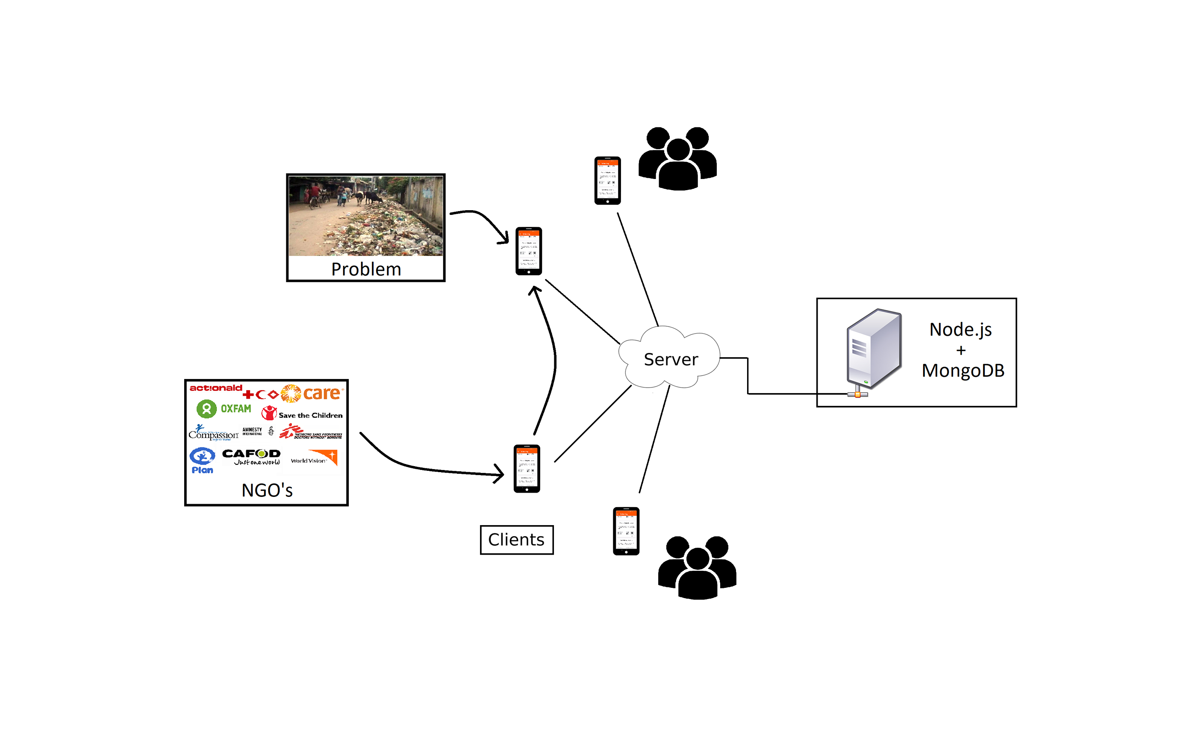
Platform Architecture

Slide 6
Applications
Repairing of Roads.
Roadside Advertisements clean-up.
To supply the needs of orphanages.
Planting trees on road side/gardens.
Stray pet control in the neighbourhood.
Cleaning up of garbage pile up in the neighbourhood.

Slide 7
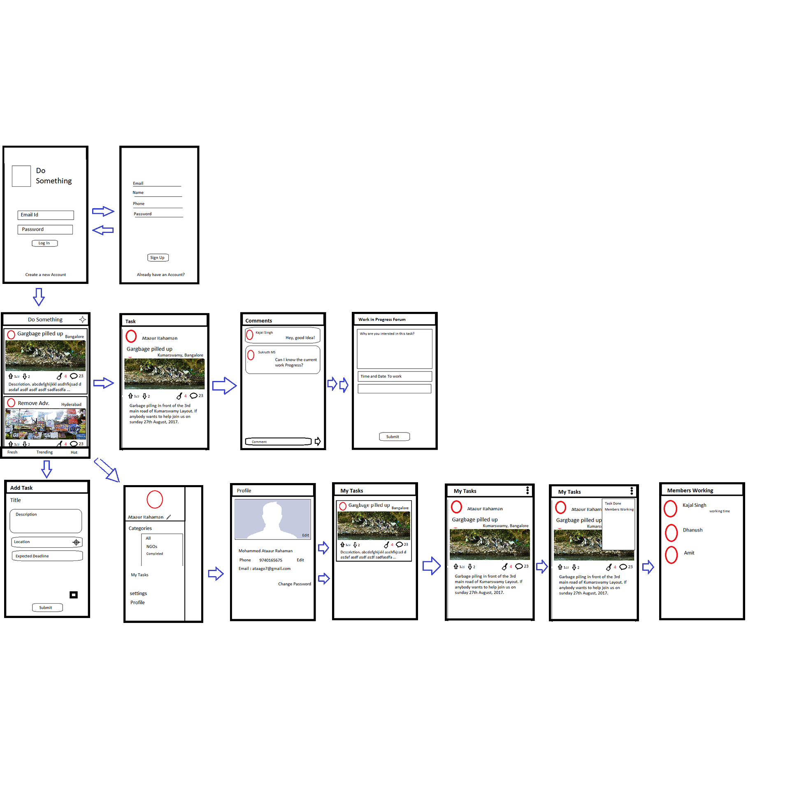
Layout Plan

Slide 8
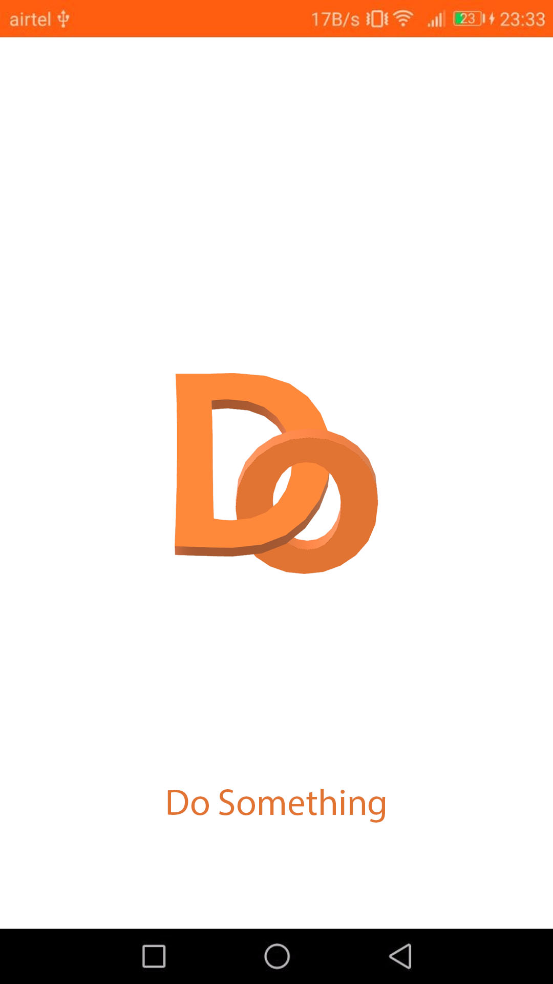
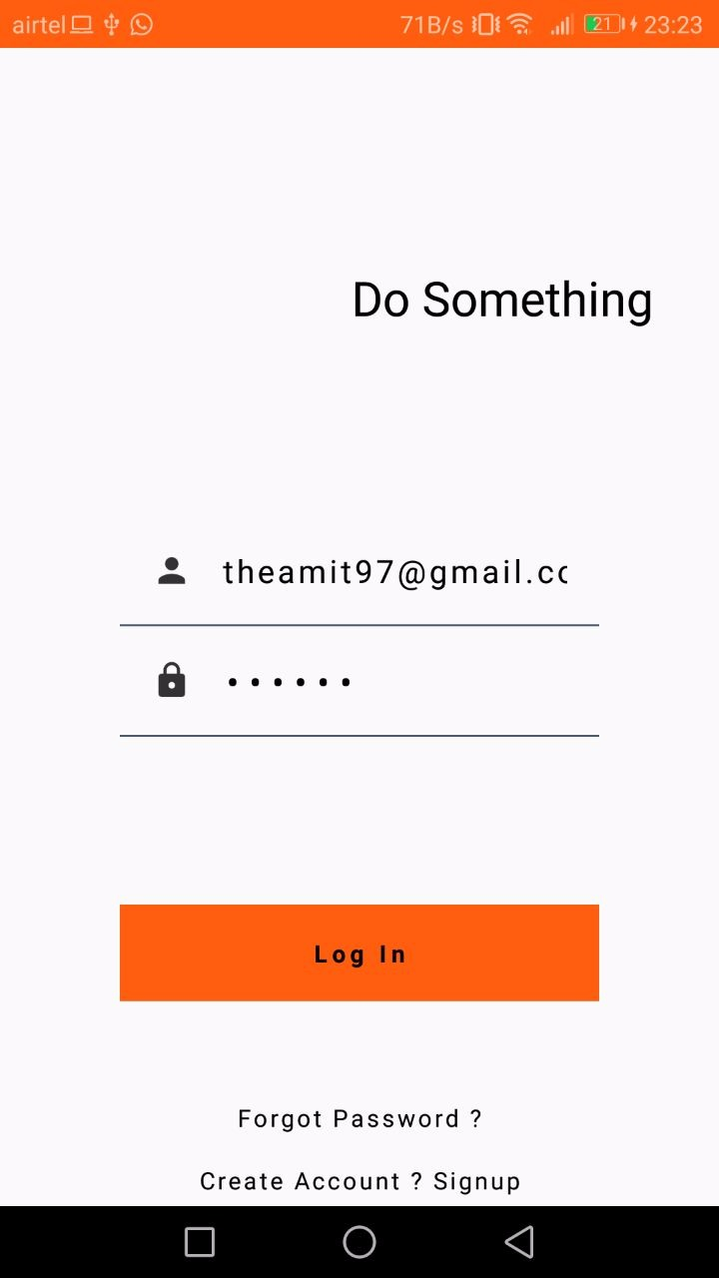
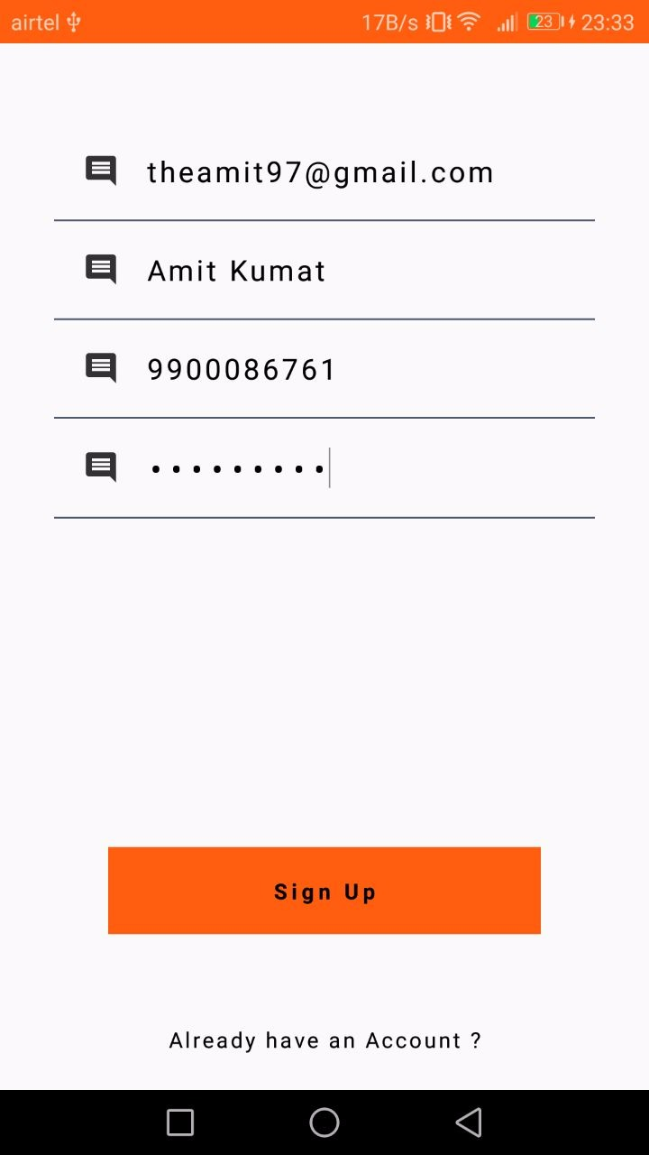
Screenshots from final working App.
Splash Screen
Log In Page
Sign Up Page

Slide 9
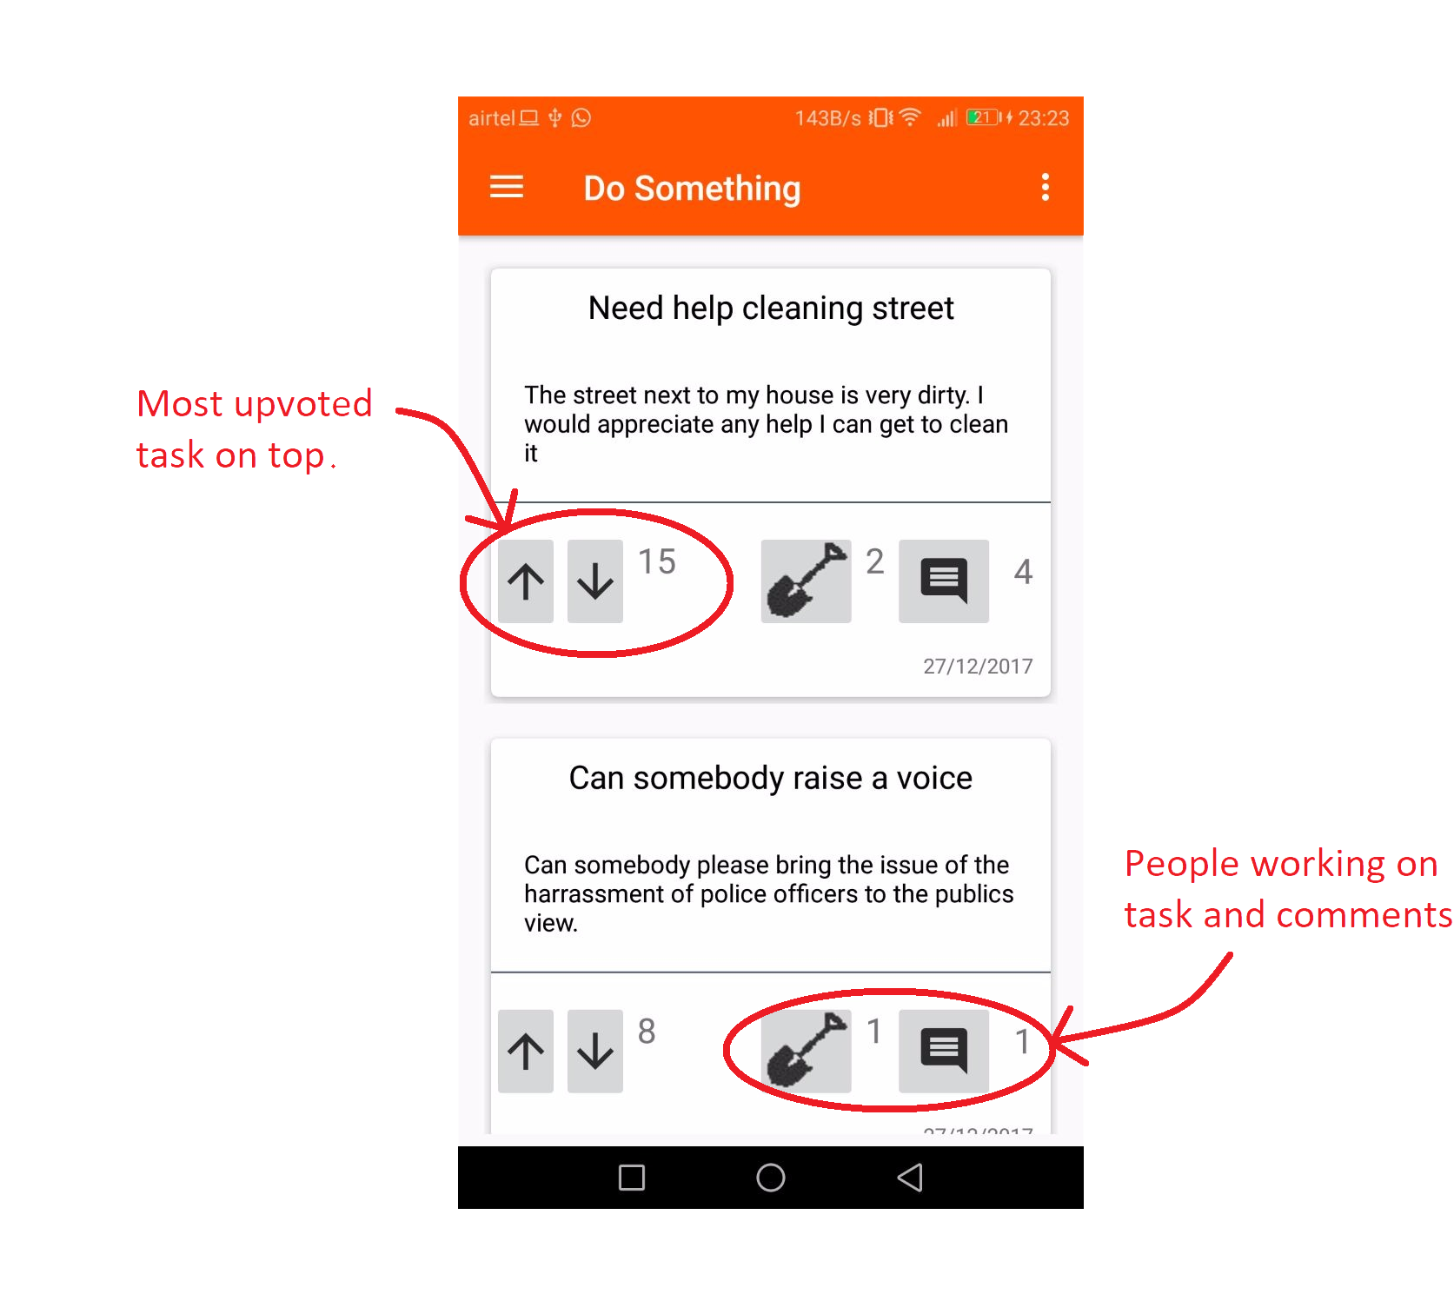
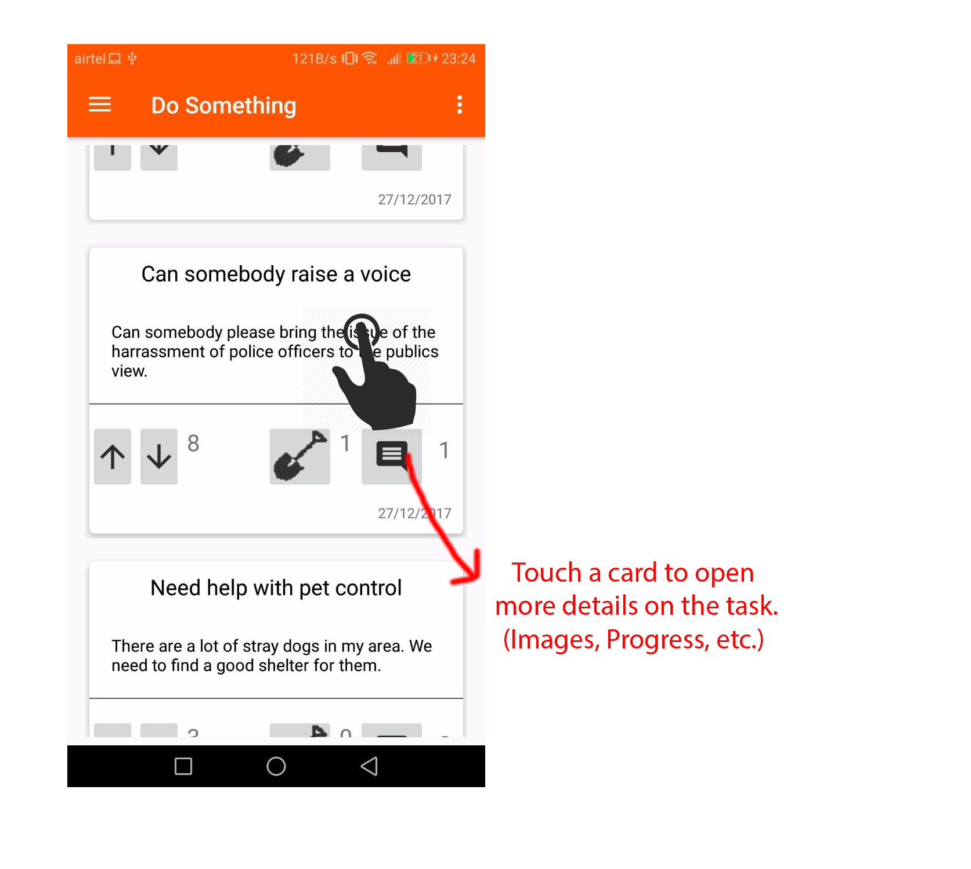
Main Page

Slide 10
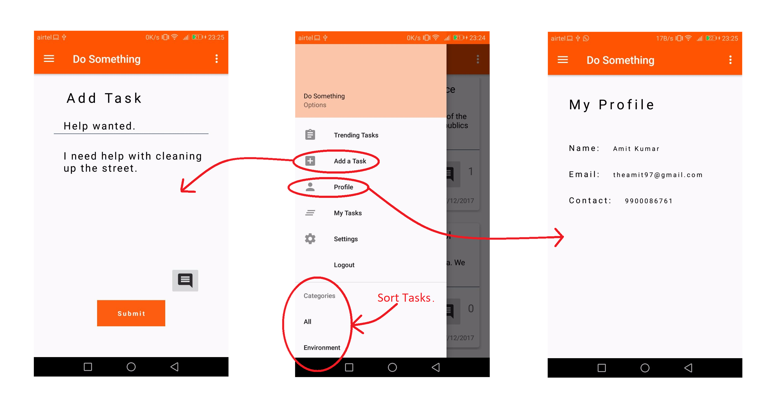
Add Task
Navigation Drawer
Profile Page

Slide 11
Contributors
Amit Kumar Gupta (Leader) – Lead Backend & Frontend Programmer.
Mohammed Ataaur Rahaman – Lead Designer & UI Frontend.
Kajal Kumari – Concept Artist and Designer.
Dhanush Prabhakar – Concept Artist.
Sukruth MS – Helped with Design.

Slide 12
Thank you

